Slide 1


Fake News Detection
Using Federated Learning
Abhigyan Varma
T.Y. B.Tech ECE – AI ML
Notes:
1

Slide 2

THE CHALLENGE
The Threat of Misinformation
Rapid Spread of Misinformation
The uncontrolled dissemination of fake news on social media platforms poses a significant threat to public discourse and trust.
Current System Limitations
Centralized AI models demand extensive user data collection, raising privacy concerns.
Require high communication bandwidth.
Struggle with localized or edge-level data sources.
Notes:
2

Slide 3


OUR APPROACH
Proposed Solution: System Architecture
Federated Learning (FL)
Blockchain Integration
Instead of moving data, we send the model to the data, enabling local training on edge devices. Only model weights are shared, enhancing privacy.
Ensures integrity of model updates by preventing malicious weight manipulation (model poisoning). Creates a verifiable audit trail of trusted sources.
This dual approach aims to build a robust, privacy-preserving, and tamper-proof system for fake news detection.
Notes:
3

Slide 4

DATA PREPARATION
Dataset & Preprocessing
01
Strict Shuffling
To prevent sequence bias during training.
02
Vocabulary Capping
Limited to 10,000 words to manage complexity and focus on core vocabulary.
03
Text Tokenization
Breaking down text into individual words or sub-word units.
Dataset Used: ISOT Fake News
Comprising 44,898 articles, this dataset provides a comprehensive base for training and evaluation.
04
Sequence Padding
Labeling Strategy
All article sequences are standardized to a length of 300 words for consistent input.
1 = Real News
0 = Fake News
Notes:
4

Slide 5

MODEL DESIGN
Deep Learning Model: Bi-LSTM
Embedding
Bi-LSTM
Why Bidirectional LSTM?
Captures long-term dependencies in text.
Understands contextual flow by processing text both forward and backward.
Effective in detecting subtle deceptive phrasing characteristic of fake news.
Dense
Dropout
Architecture Overview
Embedding Layer: Converts words to numerical vectors.
Bi-LSTM Layer: Processes sequences in both directions.
Dense & Dropout Layers: For feature learning and regularization.
Sigmoid Output: Binary classification for 'real' or 'fake' news.
Notes:
5

Slide 6

IMPLEMENTATION
Federated Learning Simulation (FedAvg)
Experimental Setup
The dataset was horizontally partitioned across 5 simulated edge clients.
Each client performed local training for 1 epoch on its private data.
Aggregation Strategy: FedAvg
The central server used Federated Averaging (FedAvg) to create a global model, which is a weighted average of client updates.
This simulation demonstrates the feasibility of decentralized learning while upholding user privacy principles.
Notes:
6

Slide 7
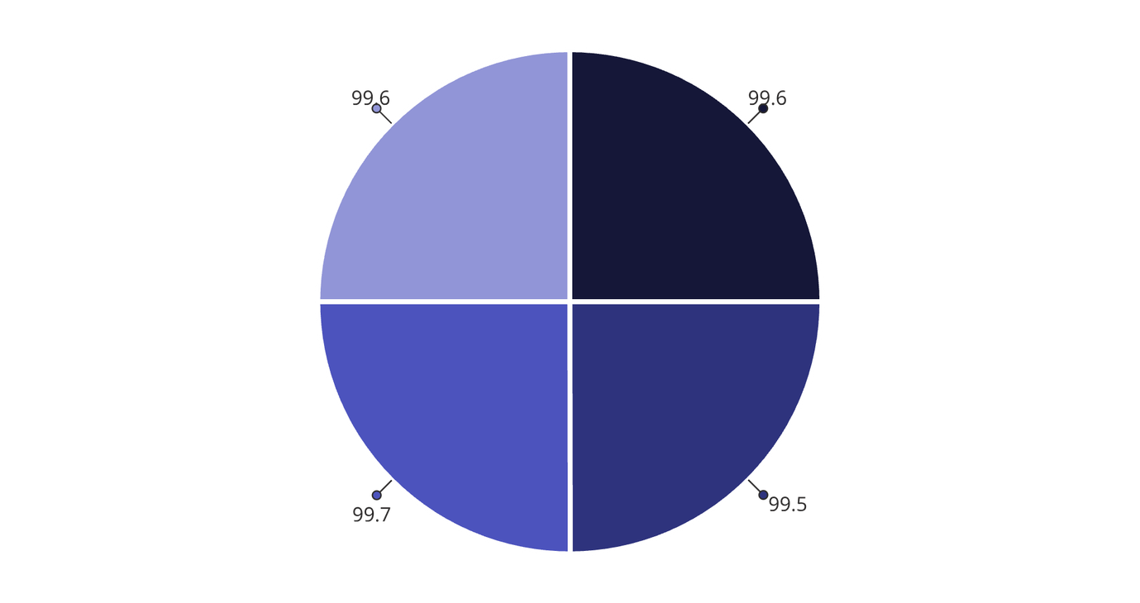
INITIAL RESULTS
Evaluation Metrics: High Performance
Performance Achieved
The model demonstrated an impressive Accuracy of 99.6% during initial evaluations.
Additional Metrics
Remarkably high Precision for both classes.
Strong Recall, indicating minimal false negatives.
Excellent F1-Score, reflecting robust performance across the board.
Accuracy
Precision
Recall
F1-Score
The model appeared to perform exceptionally well, achieving near-perfect results on both real and fake news detection.
Notes:
7

Slide 8

CRITICAL ANALYSIS
Crucial Discovery: Dataset Bias & Data Leakage
The Hidden Trap
Upon deeper analysis, we uncovered a significant flaw: nearly all "real" news articles in the ISOT dataset began with a Reuters dateline.
Example: "WASHINGTON (Reuters) -"
The Bi-LSTM model had learned this superficial pattern as a shortcut, rather than understanding the underlying semantic content.
Experimental Proof
When a demonstrably fake sentence was artificially prefixed with "WASHINGTON (Reuters) -", the model confidently classified it as REAL with almost 100% certainty.
Conclusion
This highlights a classic case of dataset bias and data leakage, where the model learned publisher cues instead of true semantic meaning.
Notes:
8

Slide 9
Future Work & Improvements
1
2
Data Cleaning Improvements
Enhanced Federated Simulation
Implement Regex to effectively strip datelines and publisher names, forcing the model to learn semantic content.
Increase communication rounds, simulate real-world edge latency, and introduce adversarial clients to robustly test the system.
These steps aim to overcome current limitations and build a truly resilient, decentralized fake news detection system.
Notes:
9

